Slide 1

Object-Oriented Programming & Objects in Python
CISC 160
Data Structures
Brian Grey

Slide 2
What are we doing today?
Object-Oriented Programming
Theory
Benefits
OOP in Python
How to create objects
Differences from theory
Tricks and quirks in Python

Slide 3
Why Object-Oriented?
We’ve seen the traditional programming structures in Python:
Variables
Arrays (Lists)
Functions
What do they all have in common?
More specifically, what can they all access?
Shared state space
What does this mean?

Slide 4
Why Object-Oriented?
Central to object-oriented design is the segregation of state space
Each object is its own program
Each object also has its own state space
If an object wishes to know the state of another object, how is this done?
1) Explicitly granted permission
2) Objects communicate via messaging
This prevents unauthorized access across state spaces
Allows the object to control its own information

Slide 5
Object-Oriented Programming (Formally)
An imperative programming paradigm where programming problems are modeled as a set of objects
Objects encapsulate the state and behavior of the program
Objects communicate by passing messages between them
Objects know how to communicate with each other but all other implementation details are hidden in a “black box”
Inputs and resulting outputs are defined but how they are determined is unknown
Wikipedia lists common examples of OO languages as Java, C++, C#, Python, PHP, JavaScript, Ruby, Perl, Object Pascal, Objective-C, Dart, Swift, Scala, Common Lisp, MATLAB, and Smalltalk.

Slide 6
Definitions
Class
The code-based template for an object
A class defines the how an object behaves and what data is stored about the object
Object
A single instance of a class
Each object has the same basic format but contains its own state
Example:
Lists all have the same basic structure but can have wildly different contents, including values, types, or lengths

Slide 7
Definitions
Instance Variable
A variable inside of a class that will hold data that defines an object’s state
Method
A subprogram, similar to a function, that defines some aspect of an object’s behavior
Has access to all instance variables within the object
Otherwise, defined and follows all the same rules of a function
Methods, and the parameters and return values associated, are the way that objects pass messages between each other

Slide 8
Definitions
Interface
The set of all publicly visible methods for a class or object
This defines how other objects can interact with an object
Note: for some languages, this is also a specific keyword that means a very specific thing
An “Interface” file syntactically and structurally defines a hierarchy of objects that, at a minimum, implement a given set of methods (or interface)

Slide 9
Principles of OOP
Three principles that drive ALL OOP design and languages:
Encapsulation
Inheritance & Abstraction
Polymorphism & Modularity
Encapsulation
Process of information hiding which keeps other objects from seeing internal details of object implementations

Slide 10
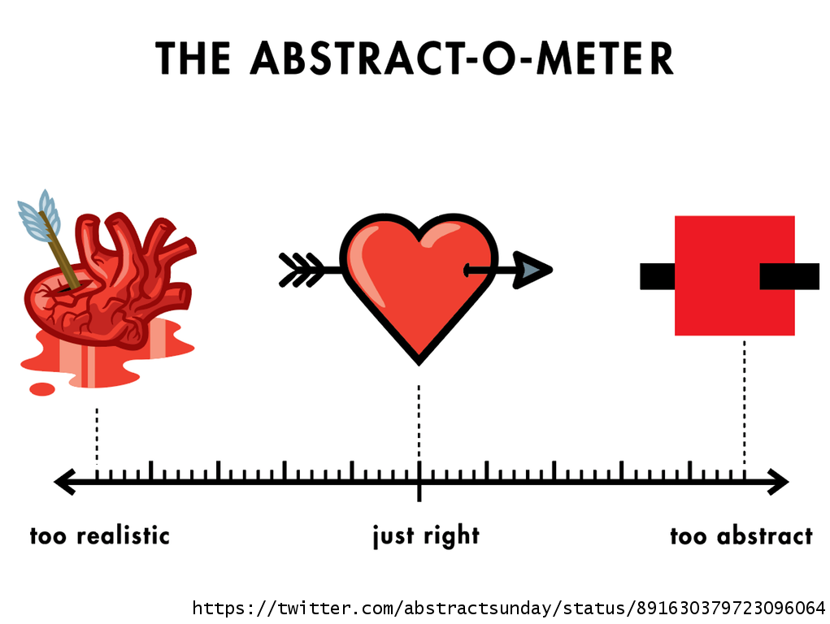
Principles of OOP
Inheritance & Abstraction
Process of code reuse where classes can be derived from existing classes
The derived class is a subclass
The class derived from is a superclass
The subclass automatically inherits all state and behavior from the superclass
State and behavior can be added
State and behavior can be changed/overridden
Incorporating inheritance results in an object hierarchy

Slide 11
Principles of OOP
Polymorphism & Modularity
From Greek, poly = many, morph = forms or shapes
The concept that the same exact same action can be handled differently by different object
This relates to subclasses overriding behavior of super classes and to duck typing
The interpreter will try to handle a method call within the specific class of the invoking object
If the definition cannot be found there, the interpreter will continue to search at the immediate super type
This continues until a definition is or cannot be found

Slide 12
Benefits of OOP
Benefits include:
Clear, modular structure
Provides clear structure and context to data
Classes can be reused in other applications as their contexts are fully encapsulated
Extending an object to new functionality is quick and direct
“Cannibalizing” an object for slightly altered functionality is quick and direct
A VAST library of design patterns using OOP already exist

Slide 13
Drawbacks of OOP
Drawbacks include:
Behavior is tied to object state so creating or associating methods can sometimes be very unnatural
Strict adherence to OOP can lead to bloated code or single use functions that only call other functions
There can be some nasty code overhead even for simple objects
OOP can be slower due to the enforced structure
Additional rules reduce speed of code because source code moves further away from the underlying hardware
Has been greatly mitigated with modern compilers/interpreters

Slide 14
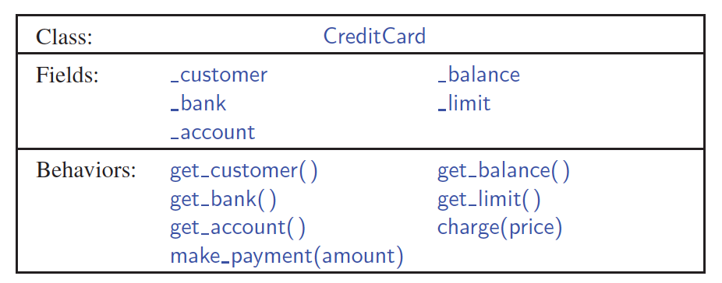
Defining an Object Generally
Many languages/standards such as UML exist
Unified Modeling Language
Below is a UML class diagram which defines the name of the class, instance variables, and behavior/methods:

Slide 15
Defining an Object Generally
When designing an object ask yourself:
What data describes it?
How does it behave?
Does it encapsulate all data needed to define its behavior?

Slide 16
Defining an Object in Python
Class definition has the following format:
class <name>[(<super-class>)]: <constructor> <method-declaration>*
This seems minimal, doesn’t it?
Where is the state stored?
Put another way, where are the instance variables defined?

Slide 17
Defining an Object in Python
Constructor
def __init__(self[, <parameter-list>]): <statements>
Allocates memory for and initializes the internal structure of an object
What is self?
A keyword that refers to this newly created object
MUST be used when referring to attributes or methods of itself

Slide 18
Defining an Object in Python
Constructor
def __init__(self[, <parameter-list>]): <statements>
Again, where is the structure of object state defined?
In the constructor (or, if we’re being precise, the initializer)
The body of statements should be used to set up the object
This includes things like setting up default variables or saving parameters to instance variables
Remember: variables exist when executed in an interpreted language

Slide 19
Defining an Object in Python
Invoking a Constructor
<var-name> = <class-name>(<arguments>)
This calls the constructor with the list of arguments
You will not include self in that list so the argument-list will have one less element than the formal parameters
The result is an object referenced by the variable with the state defined by the parameters
l = list((1,2,3))

Slide 20
Defining an Object in Python
Methods
def <name>(self[, <parameter-list>]): <statements>
Defines a specific behavior for an object
Operates like a function, down to parameters and return values
Like with __init__, self is required as the first parameter
This is how the interpreter understands that this is a method of this object and not a function that only has scope in this space

Slide 21
Defining an Object in Python
Method types:
“Getters”
Get some aspect of state from the object
Functionally, return some value from the object
Possibly with some light processing
Typically, read-only

Slide 22
Defining an Object in Python
Method types:
“Setters”
Set some aspect of state from the object
Functionally, save some parameter into the state of the object
Possibly with some light processing
Typically, “write-only”
May return a value representing some sort of success condition or otherwise representing the new state of the object

Slide 23
Defining an Object in Python
Method types:
Are there other types of methods?
Absolutely!
Not all methods will fit neatly into this “only one thing” paradigm
Many will
It is okay if you look and see methods or behaviors that are not cleanly getters or setters
If most of your methods are neither getters or setters, give your design another look-over

Slide 24
Instance Variable Names
Have you noticed what character our instance variables all start with?
All instance variable SHOULD start with an underscore (_)
This is a coding standard, not a syntactical requirement
Why?
Unlike languages with public/private visibility modifiers, Python has no way to enforce encapsulation & information hiding
The underscore represents verboten aspects of the object which you are not to directly manipulate
Use the publicly agreed-upon interface the coder provided

Slide 25
Let’s do an example!

Slide 26
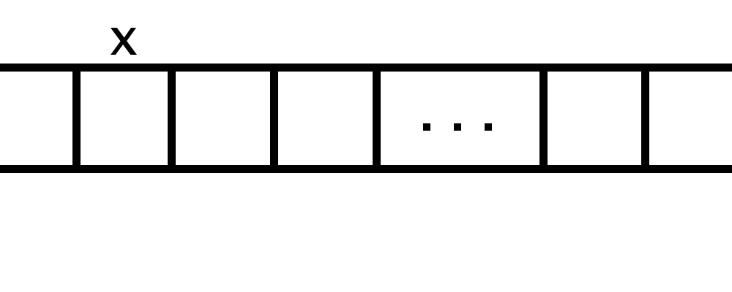
What is a Variable? REALLY?
Suppose you have the following variable declaration:
X = 10
What happens inside of the computer?
But is this complete? Where’s the 10?

Slide 27
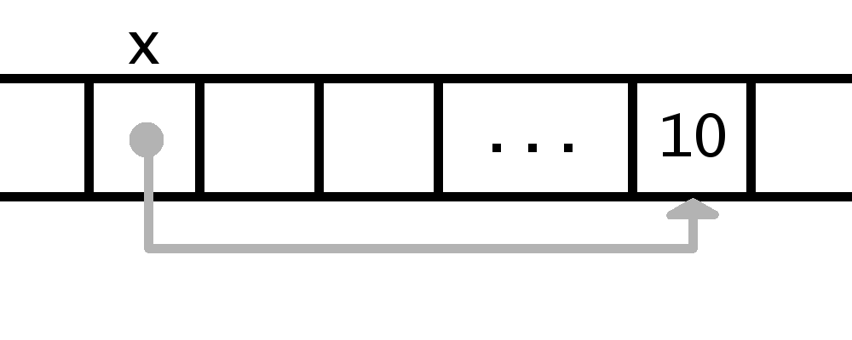
What is a Variable? REALLY?
Suppose you have the following variable declaration:
X = 10
What happens inside of the computer?
The variable name refers to memory address and points at 10
This seems like a pain. Is this universal?

Slide 28
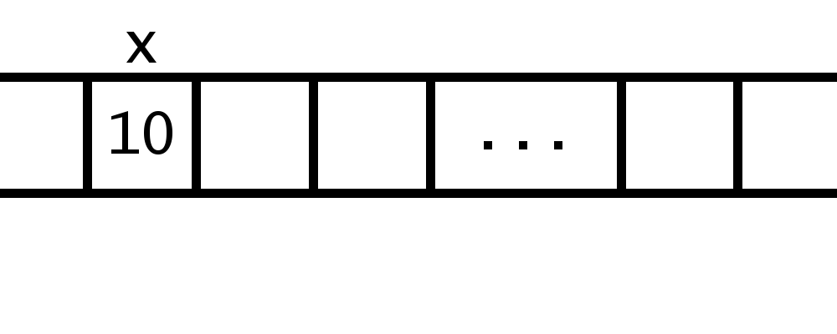
Primitives, Pointers & References
These are the three ways languages can handle variables
Primitives
Stores the information right at the memory address of x
Works great for simple values but not complex objects
Lower and mid-level programming languages may do this for ints, chars, floats, etc.

Slide 29
Primitives, Pointers & References
These are the three ways languages can handle variables
Pointers & References
Instead of storing the value, the language stores a memory address where the value is stored
Pointers and references are largely the same except pointers are treated like any other data
You may type pointer += 4 to move 4 memory addresses up
References store some additional information (variable type) and restrict/protect the programmer
Python & Java use references; C & C++ use pointers

Slide 30
Copying & Passing Variables
What does this mean when copy or pass a variable?
The line x = y means “dump the contents of y into x”
What are the contents?
The memory address of the information y is holding
This is what happens when data is copied
The same happens when arguments are passed into functions
The memory address of the information is sent into the function
Called passing by value
This allows the function to alter the contents (if possible)

Slide 31
Copying Objects
Aliasing
Copies a reference to the main, copied object
Results in two references to the same object in memory
Shallow Copy
Creates a new instance of the structure of the object but only copies original references to internal data
Results in two, separate copies referring to the same internal data
Deep Copy
Copies the structure of the object then creates copies of the internal data

Slide 32
Copying Objects
How are parameters to functions and methods handled?
Aliasing
What is the result if we pass in mutable objects?
Changes in the function/method are reflected externally
How do we create a shallow copy?
Call the constructor of the object
Ex: new_list = list([1,2,3])
How de we create a deep copy?
copy.deepcopy()

Slide 33
Magic Methods
Okay, then what’s up with __init__ using underscores?
All objects have a set of hidden methods that control meta-level behavior
__init__ controls how the object behaves at initialization
Specific magic methods will be brought up as needed
Redefining a magic method is as simple as creating a new __init__ method
Provide the proper parameters and then define behavior
A how-to on using them can be found here and the Python documentation on magic methods can be found here

Slide 34
Inheritance
Allows for objects to “inherit” behavior from a super-type
This behavior does not need to be redefined
Any addition state or behavior can be added
Any necessary overwriting of behavior is as simple as redefining the method
This is why __init__ works the way it does.
The subclass is considered a more specific version of the base class
Football and baseball are versions of the concept “ball”
Objects can only directly inherit from one base class

Slide 35
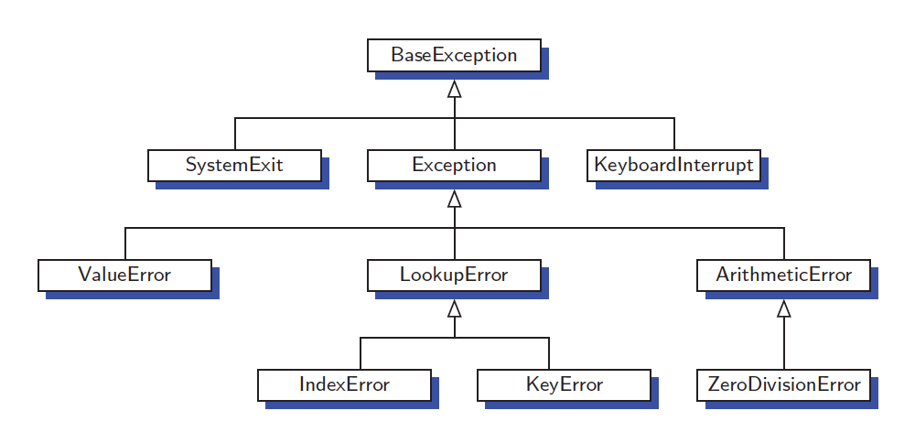
Inheritance
An example:
From Goodrich, Tamassia, Goldwasser (2013)

Slide 36
Inheritance
What if we want to keep some aspect of the base/super class’s behavior?
Example: throw a baseball versus throw a football
I mean, they’re sort of the same…
super().<method-name>(<arguments>)
Where is a great place to implement this?
super().__init__(<arguments>)
Frequently, your subclass constructor wants to store all of the same data as your base class as well as some additional data
Example: ChippedCreditCard

Slide 37
Abstracting Behavior
What if you know what actions a class should do but not how it should be done
Example: Processing a Payment object
You know that the payment will have an amount and a method
Cash versus check versus credit versus fund transfer…
Paypal versus Venmo versus Square versus Zelle..
We might want to define that there any subclass implement specific methods without offering a base behavior

Slide 38
Abstract Classes
A class that cannot be instantiated (constructed)
from abc import ABC, abstractmethod class <name>(ABC):
Abstract classes have abstract methods
Methods with a signature but no implementation
@abstractmethod def <name>(self[, <parameter-list>): pass
One last example
Payment

Slide 39
Algorithm Development
Can be top-down or bottom-up
Top down start with general concepts and refine/break down
Bottom up starts with specific commands and generates complexity/abstraction
Let’s do an example
We have a database of students with current class lists and GPA’s. We need to run a nightly process to make sure it is accurate. At the end, we want a count of corrections made. How do we write the algorithm?

Slide 40
Questions?

